Slide 1

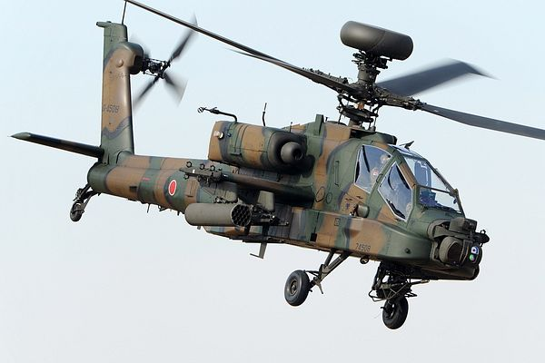
Heat Exchanger
for Demonstrator
ME476C
10-9-23
Uriah Whitaker:Team Lead
Dennis Decker:Manufacturing Engineer
Christopher Mason: Test Engineer
Lorenz Vios: CAD Engineer

Slide 2
Project Description
Project Description
Our project's primary objective is the design and creation of a liquid-to-liquid heat exchanger, with a strong emphasis on optimizing heat transfer efficiency. This advanced heat exchanger will be seamlessly integrated into a demonstrator, which serves as a practical representation of a helicopter cockpit, showcasing its ability to operate with a distinct refrigerant.
Sponsor
The project is sponsored by Boeing, a leading aerospace company. The significance of this project lies in its potential to revolutionize heat exchange technology within aviation, aligning with Boeing's commitment to innovation and efficiency in aircraft systems.
Importance
Environmental benefit:
Boeing is committed to transitioning from R-134a to R-1234yf, a more environmentally conscious refrigerant choice.
The noteworthy environmental benefit lies in R-1234yf, which has an environmental impact over 1,000 times lower in terms of climate change compared to R-134a. This transition represents a meaningful step toward sustainability.
- Safety:
It's important to note that R-1234yf, while environmentally friendly, possesses flammability risks.
The heat exchanger's vital role is to safeguard the cockpit from potential fires, ensuring the highest level of safety for both aircraft systems and personnel.
- Innovation:
This project serves as a testament to Boeing's unwavering dedication to innovation, a core principle driving their constant pursuit of advancements that enhance aircraft performance and sustainability.
The development of a more efficient and secure heat exchanger aligns perfectly with Boeing's commitment to pioneering aviation technology.
Uriah 10/10 BoeingHX F23toSp2405, 1

Slide 3
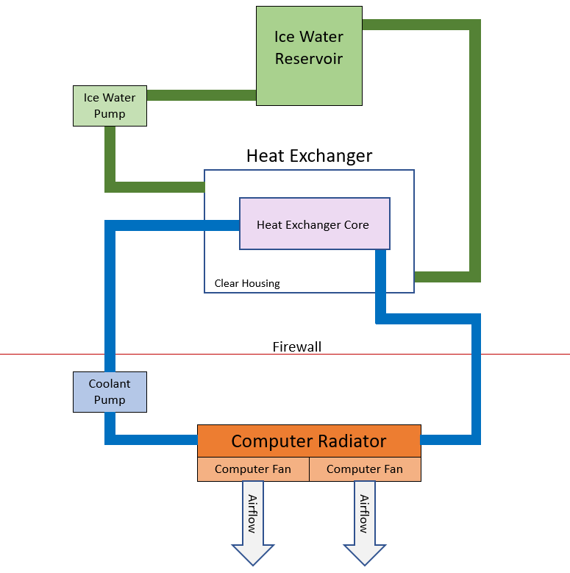
Project Description
Uriah 10/10 BoeingHX F23toSp2405, 2
Fig 1. Demonstrator Visual

Slide 4
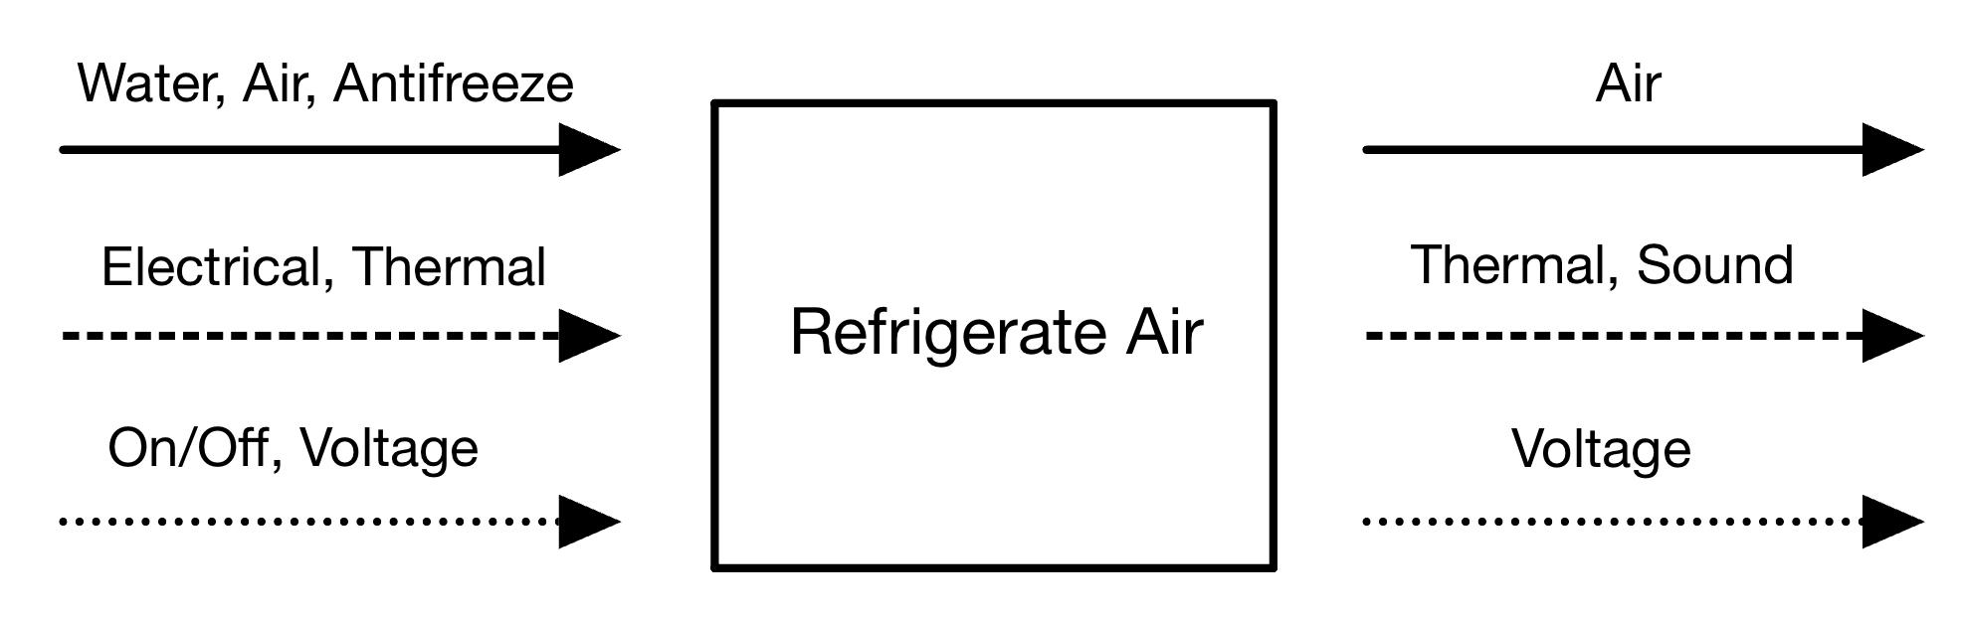
Black Box Model
Fig 2. Black Box Model
Lorenz 10/10 BoeingHX F23toSp2405, 3

Slide 5
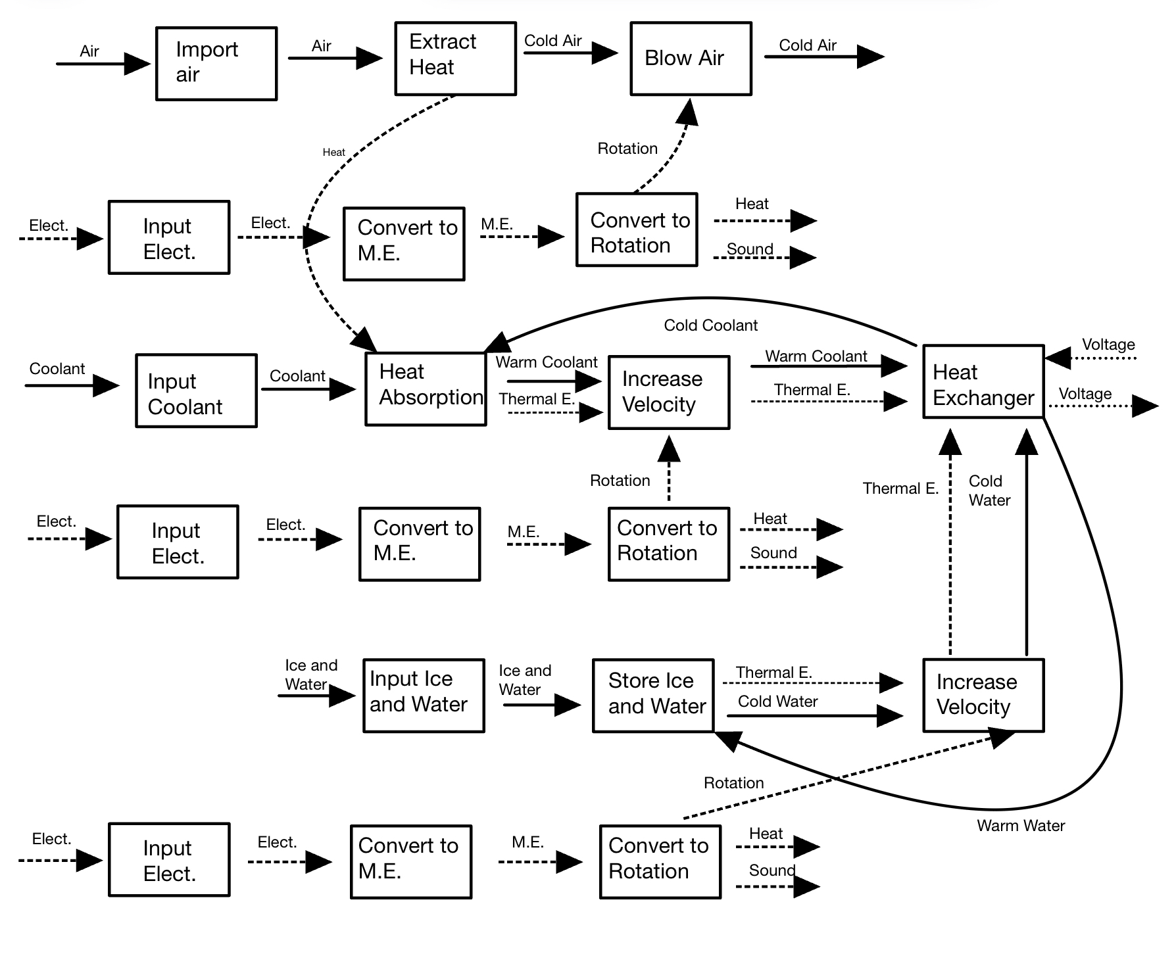
Functional Model
Chris 10/10 BoeingHX F23toSp2405, 4
Fig 3. Full Functional Model

Slide 6
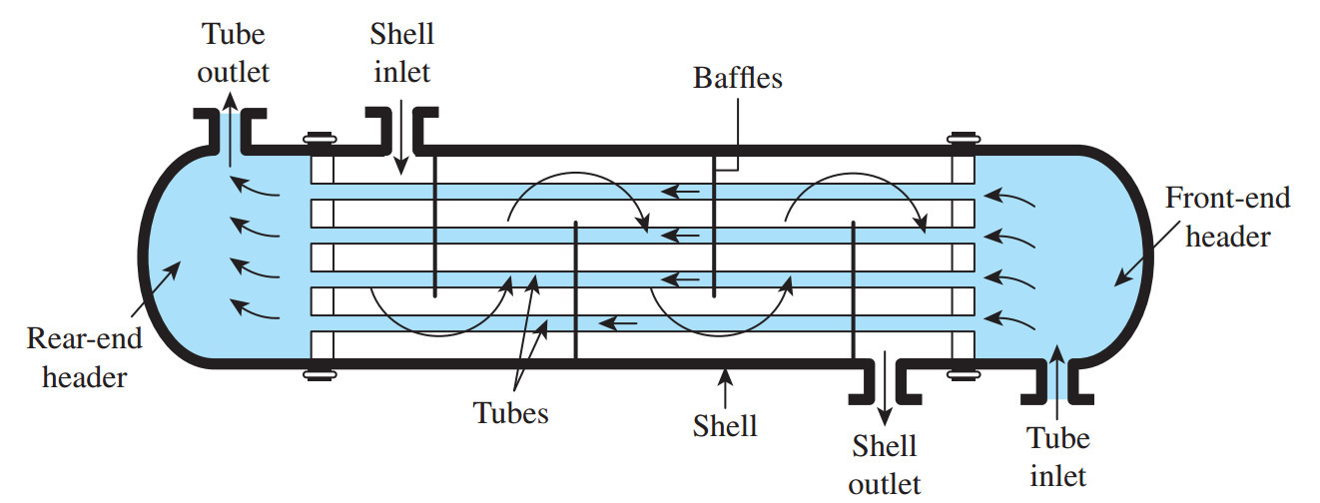
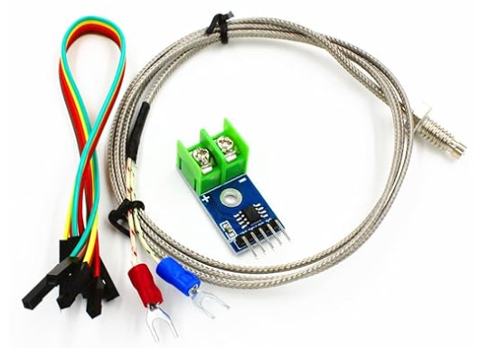
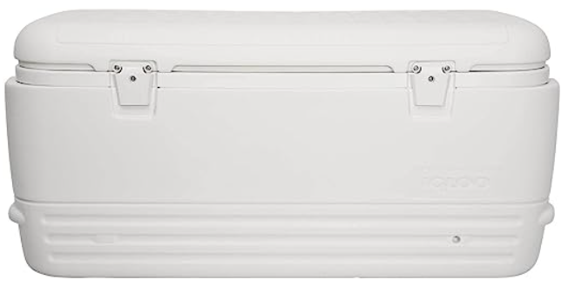
Concept Generation
Heat Exchanger Type (Lorenz)
Manufacturing Expenses
Pressure Drop
Surface Area
Heat Exchanger Heat Transfer (Dennis)
Thermal Conductivity
Environmentally Safe Coolant
Ice Water reservoir selection (Chris)
Heat Transfer through cooler wall
Amount of Ice
Amount of water to complete one loop
Thermocouple selection (Uriah)
Accuracy
Cost
Fig 4. Shell and Tube Heat Exchanger
Fig 6. Polystyrene Cooler
Fig 5. K type Thermocouple with Arduino
Dennis 10/10 BoeingHX F23toSp2405, 5

Slide 7
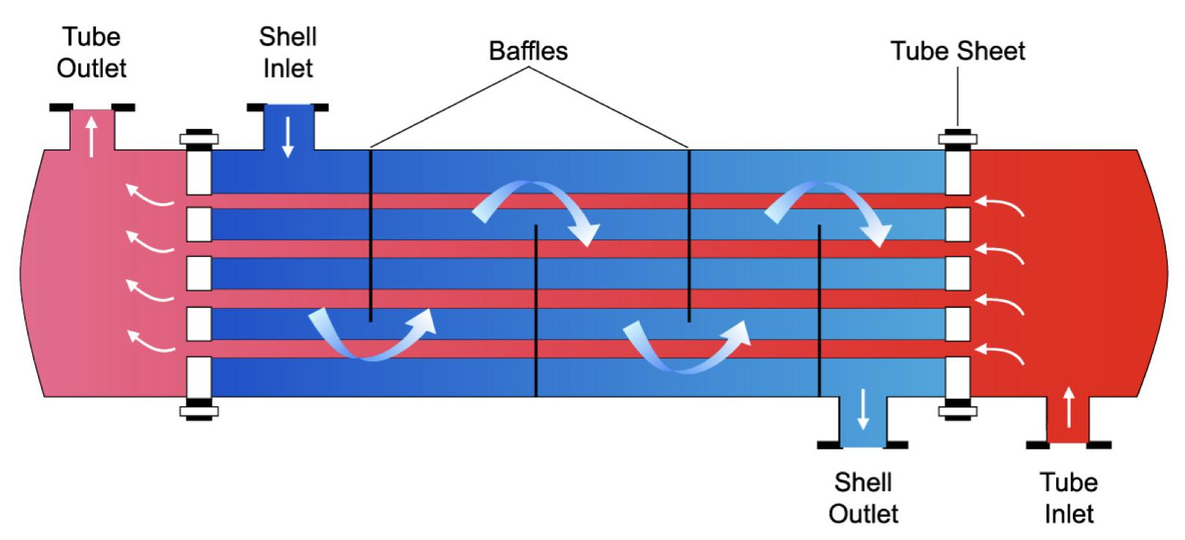
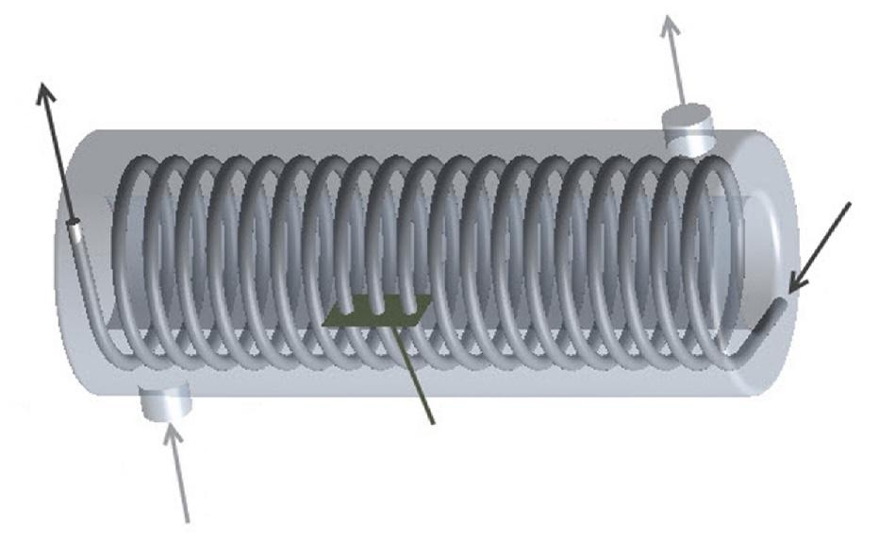
Preliminary Concepts
Design A:
Tube Material: Copper
Coolant: 50/50 Propylene Glycol
Heat Exchanger Type: Straight Tube and Shell; 1 pass
Cooler Insulation: Polyurethane
Design B:
Tube Material: Aluminum
Coolant: 50/50 Ethylene Glycol
Heat Exchanger Type: Coiled Tube and Shell
Cooler Insulation: Polystyrene
Fig 7. Shell and Tube Heat Exchanger
Fig 8. Shell and Coil Heat Exchanger
Dennis 10/10 BoeingHX F23toSp2405, 6

Slide 8
Heat Exchange Heat Transfer
Assumptions
-T_{hi} is equal to ambient air temperature (𝞰=100% for radiator)
-Fully Developed Flow
-S.S. Flow
-Adiabatic Heat Exchanger Shell
-Negligible Kinetic and Potential energy effects
-Conduction effects negligible
Main Dependent equations [1]
Nu_{c}=C*Re_{c}^m*Pr_{c}^(⅓) Nu_{H}=.0243*Re_{H}^(⅘)*Pr_{H}^(⅖) h=Nu*k_{f}/d
q=(T_{hi}-T_{co})/R_{eq} ΔT=q/(ṁ_{h}*C_{h}) ε=q/q_{max}
Terms (Subscripts p,e,c denote 50/50 water-propylene, 50/50 water-ethylene, and water respectively)
Nu-Variable to denote convection effectiveness of fluid
Re-Reynolds number of fluid flow
Pr-Dimensionless number that correlates viscosity and thermal conductivity h-heat transfer coefficient of fluid
k_{f}-thermal conductivity of fluid
T_{hi}-Temperature of hot fluid at inlet
R_{eq}-thermal resistance due to convection and conduction
T_{co}-Temperature of cold fluid outlet
ΔT-Change of temperate along same fluid
ṁ_{h}-Mass flow rate of coolant
C_{h}-Specific heat capacity of hot fluid ⍴-Density of fluid
V_{s}-Velocity of Fluid in Shell
Variables
μ_{p}=.00505 (pa*s) μ_{e}=.0042 (pa*s) μ_{e}=.00089 (pa*s)
⍴_{p}=1038 (kg/m^3) ⍴_{e}=1115 (kg/m^3) ⍴_{c}=998 (kg/m^3)
C_{pp}=3.74 (kJ/kg K) C_{pe}=3.14 (kJ/kg K) C_{pc}=4.18 (kJ/kg K)
Pr_{p}=51.83 Pr_{e}=19.61 Pr_{c}=13.6
k_{fp}=.393 (W/m*K) k_{fe}=.426 (W/m*K) k_{fc}=.598 (W/m*K)
ṁ_{p}=.28 (kg/s) ṁ_{e}=.261 (kg/s) ṁ_{c}=.252 (kg/s)
d_{Ai}=.00635 (m) d_{Bi}=.0137 (m) V_{a}=1.32 (m/s)
V_{B}=1.99 (m/s) V_{s}=.0386 (m/s) C=.683[1]
m=.466[1] A_{A}=.0532 (m^2) A_{A}=.288 (m^2)
Dennis 10/10 BoeingHX F23toSp2405, 7

Slide 9
Heat Exchange Heat Transfer
Solution
Equation Design A Design B
1) Re_{i}=⍴*d*V_{i}/μ (1038*.00635*1.32)/.00505=2166.64 (1115*.0137*1.99)/.0042=7425.67
2) Re_{o}=⍴*d*V_{o}/μ 998*.00635*.0386/.00089=274.85 998*.137*.0386/.00089=592.99
3) Nu_{I}= .0243*Re_{H}^(⅘)*Pr_{H}^(⅖) .0243*2166.64^(⅘)*51.83^(⅖)=54.96 .0243*7425.67^(⅘)*19.61^(⅖)=97.87
4) Nu_{E}=C*Re_{c}^m*Pr_{c}^(⅓) .683*274.85^.466*13.6^(⅓)=22.13 .683*592.99^.466*13.6^(⅓)=27.57
5) h_{I}=Nu*k_{f}/d (W/m^2*k) 54.96*.393/.00635=3401.63 97.87*.426/.0137=3640.78
6) h_{E}=Nu*k_{f}/d (W/m^2*k) 22.13*.589/.00635=1667.72 22.13*.589/.0137=1203.81
7) R=∑1/(h*A) (K/W) (1/3401.63*.0532)+(1/1667.2.0532)=.0167 (1/3282.96*.288)+(1/1203.81*.288)=.00393
8) Req=(∑1/R)^-1 (K/W) (6/.0192)^-1=.00279
9) q=((T_{hi}-T_{co})/R_{eq})/1000 (kW) ((24-0)/.00279)/1000=8.602 ((24-0)/.00394)/1000=6.091
10) ΔT=q/(ṁ_{h}*C_{h}) (ºC) 8.602/(.28*3.74)=8.21 6.091/(.261*3.14)=7.43
11) q_{max}=C_{m}(T_{hi}-T_{co}) (kW) (.252)(4.18)(24-0)=25.2 kW
12) ε=q/q_{max} 8.602/25.2=.341=34.1% 6.091/25.2=.242=24.2%
Dennis 10/10 BoeingHX F23toSp2405, 8

Slide 10
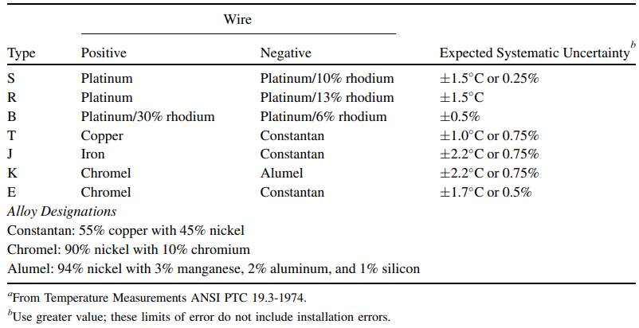
Choosing the thermocouple
Table 1. Types of Thermocouples and properties [3]
Uriah 10/10 BoeingHX F23toSp2405, 9
Notes:
A thermocouple can be made of different metals. The metals used will affect the voltage range, cost, and sensitivity. There are standardized metal combinations that result in different thermocouple types: B, E, J, N, K, R, T, and S.
B-Type- The alloy combination is of Platinum (6% Rhodium) and Platinum (30% Rhodium). This thermocouple exhibits a temperature range between 1370 to 1700 °C. It is mainly used in applications executed at extremely high temperatures, such as glass production.
E-Type- Chromel and Constantan are the alloys that form an E-type thermocouple. The temperature range is between 0 to 870 °C. This thermocouple does not focus on the oxidation in the atmosphere and can be used in an inert environment. However, they need to be protected against the sulfurous environment. They are commonly used in power plants.
J-Type- J type of thermocouple is formed with Iron and Constantan. 0 to 760 °C is its temperature range. Owing to the low-temperature range of the thermocouple, its life span reduces in high temperatures. J types thermocouple is best suited for vacuum and inert environment. Injection molding is one of the most common applications of such types of the thermocouple.
K-Type- Chromel and Alumel form a K-type thermocouple. The temperature range is between 95 and 1260 °C. The neutral or oxidizing environment is best suited for these types of the thermocouple. It generates an EMF variation below 1800°F due to hysteresis, which restricts its use in an inert and oxidizing environment below this temperature. They are most commonly used in refineries.
N-Type Thermocouple This thermocouple is a combination of alloys Nicrosil and Nisil. The temperature range is between 650 to 1260 °C. Unlike K-type thermocouples, the N-type thermocouple offers very high resistance for degradation due to green rot and hysteresis. They are most commonly used in refineries and petrochemical industries.
R-Type Thermocouple A combination of Platinum (13% Rhodium) and Platinum forms R type thermocouple. The temperature range is between 870 to 1450 °C. It is costlier than S type thermocouple as it contains a higher percentage of Rhodium. Its high accuracy and stability make it an ideal thermocouple to used in Sulfur recovery units.
S-Type Thermocouple It is a combination of Platinum (10% Rhodium) and Platinum. The temperature range is between 980 to 1450 °C. S type thermocouple is used in applications involving very high temperatures. This type is widely used across various l industries.
T-Type Thermocouple It is formed with Copper and Constantan. The temperature range is between -200 to 370°C. This type of thermocouple is suitable for the inert atmosphere as well as the vacuum. They are widely used as they generally resist decomposition even in a moist environment. They are commonly used in food production and cryogenics.

Slide 11
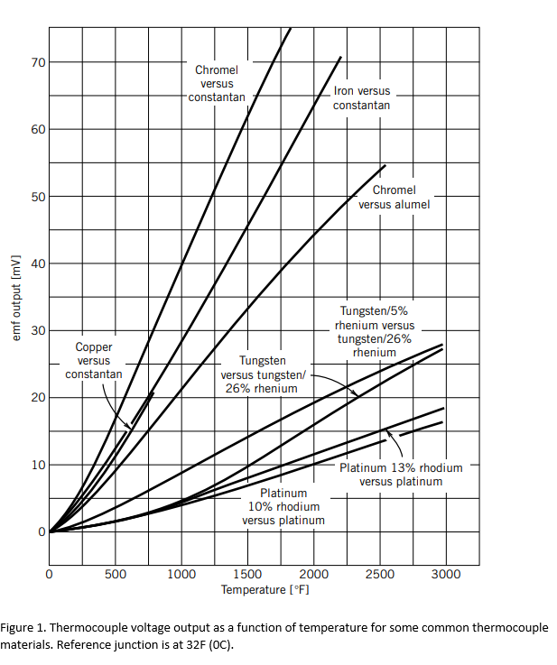
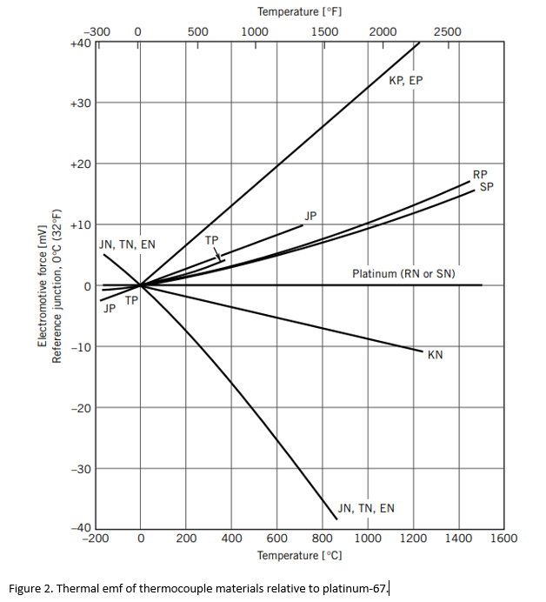
Mathematical Modeling Thermocouple
Fig 9. Thermocouple Voltage vs Temperature
Fig 10. Thermal emf of thermocouple materials
Uriah 10/10 BoeingHX F23toSp2405, 10
Notes:
looking at the emf output and the range of temperature I found all the thermocouple types are going to be able to perform accurately for our heat exchanger. the next step is to evaluate the price range for said thermocouples.

Slide 12
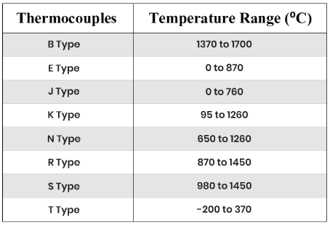
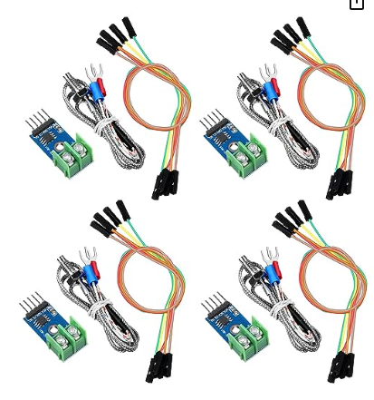

Price and Temp Range for Thermocouples
Table 2. Working Ranges of Thermocouples
Basic Thermocouples:$10 to $20 J and K type
High-Accuracy Thermocouples: $50 to outside of budget
Specialized Thermocouples: $200 +
Custom Thermocouples: too expensive
Uriah 10/10 BoeingHX F23toSp2405, 11

Slide 13
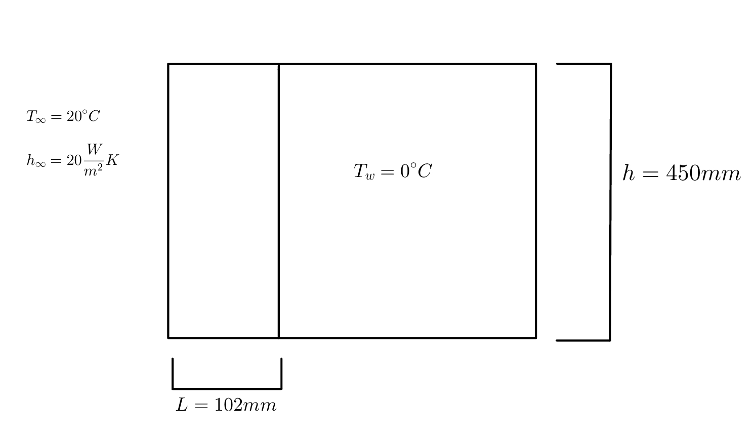
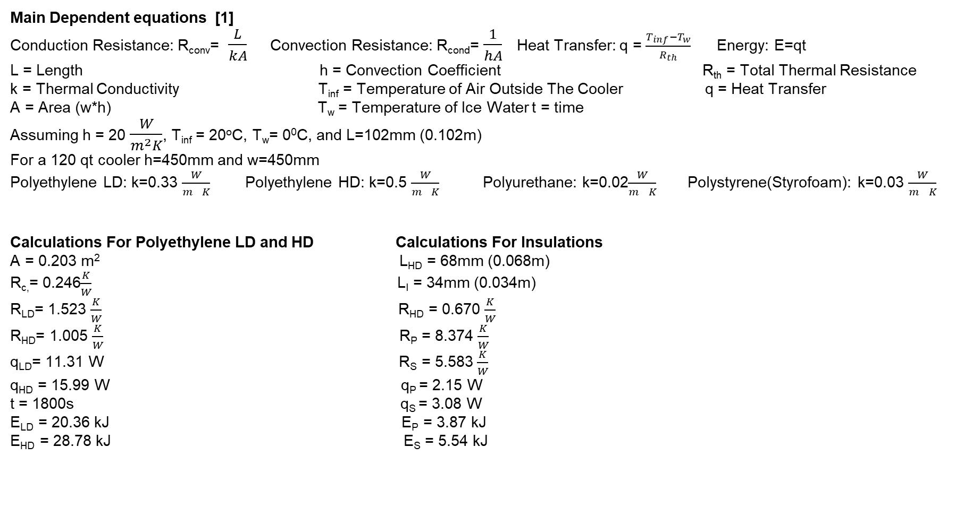
Mathematical Modeling for Reservoir Insulation
Main Dependent equations [1]
Conduction Resistance: R_{conv}= $\frac{L}{kA}$ Convection Resistance: R_{cond}= $\frac{1}{hA}$ Heat Transfer: q = $\frac{T_{inf}−T_{w}}{R_{th}}$ Energy: E=qt
L = Length h = Convection Coefficient R_{th} = Total Thermal Resistance
k = Thermal Conductivity T_{inf} = Temperature of Air Outside The Cooler q = Heat Transfer
A = Area (w*h) T_{w} = Temperature of Ice Water t = time
Assuming h = 20 $\frac{W}{m^{2}K}$, T_{inf} = 20ºC, T_{w}= 0⁰C, and L=102mm (0.102m)
For a 120 qt cooler h=450mm and w=450mm
Polyethylene LD: k=0.33 $\frac{W}{m^{}K}$ Polyethylene HD: k=0.5 $\frac{W}{m^{}K}$ Polyurethane: k=0.02$\frac{W}{m^{}K}$ Polystyrene(Styrofoam): k=0.03 $\frac{W}{m^{}K}$
Calculations For Polyethylene LD and HD Calculations For Insulations
A = 0.203 m² L_{HD} = 68mm (0.068m)
R_{c,}= 0.246$\frac{K}{W}$ L_{I} = 34mm (0.034m)
R_{LD}= 1.523 $\frac{K}{W}$ R_{HD} = 0.670 $\frac{K}{W}$
R_{HD}= 1.005 $\frac{K}{W}$ R_{P} = 8.374 $\frac{K}{W}$
q_{LD}= 11.31 W R_{S} = 5.583 $\frac{K}{W}$
q_{HD} = 15.99 W q_{P} = 2.15 W
t = 1800s q_{S} = 3.08 W
E_{LD} = 20.36 kJ E_{P} = 3.87 kJ
E_{HD} = 28.78 kJ E_{S} = 5.54 kJ
Chris 10/10 BoeingHX F23toSp2405, 12

Slide 14
Mathematical Modeling for Ice Amount
Main Dependent equations [2,4]
E = m x h_{c} x ΔT
E = Energy of the water h_{c} = specific heat capacity of water ΔT = Change in temperature
m = mass of the water
Values for initial Water in System Values for Inflowing Water
T_{i} = 20ºC T_{f} = 0⁰C h_{c} = 4.186 J/gºC V = 2.91 gal T_{i} = 6.8ºC T_{f} = 0ºC h_{c} = 4.186 J/gºC ͘ m_{fr} = 0.2527 kg/s t = 1800 s
Calculation for Initial Water in system Calculation for Inflowing Water
m = V * 3.79 = 11.02 kg m = 0.2527 x (1800) = 454.86 kg
E_{i} = m x h_{c} x (T_{i} - T_{f}) = 922.45 kJ E_{m} = m x h_{c} x (T_{i} - T_{f}) = 12947.50 kJ
Final Ice Calculation
E_{f} = E_{i} + E_{m} = 13869.95 kJ
Ice can absorb 334 kJ per kg
m_{ice} = 41.52 kg or 91.54 lbs
Chris 10/10 BoeingHX F23toSp2405, 13

Slide 15
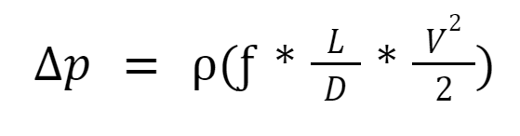
Pressure Drop Shell and Tube
Main Dependent equations [4]
p = pressure ⍴ = density V = avg. velocity
L = pipe length D = pipe diameter ƒ = friction factor (from Colebrook Eqn.)
Straight Tube
Δp = 3849.6 Pa or 0.558 psi Ethylene
Δp = 1512.3 Pa or 0.219 psi Propylene
Helical Tube
Δp = 61540 Pa or 8.925 psi Ethylene
Δp = 61747 Pa or 8.956 psi Propylene
The pump is rated to provide 45 psi at the selected flow rate, so the pump is suitable for our design in terms of pressure
Lorenz 10/10 BoeingHX F23toSp2405, 14

Slide 16
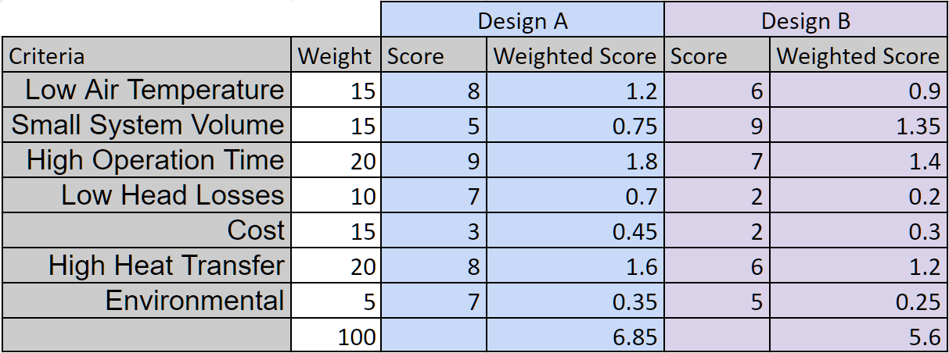
Decision Matrix
Table 2. Design Matrix
Lorenz 10/10 BoeingHX F23toSp2405, 15

Slide 17
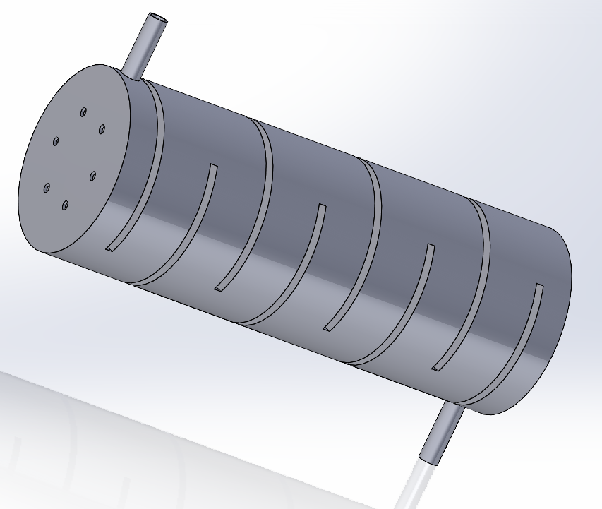
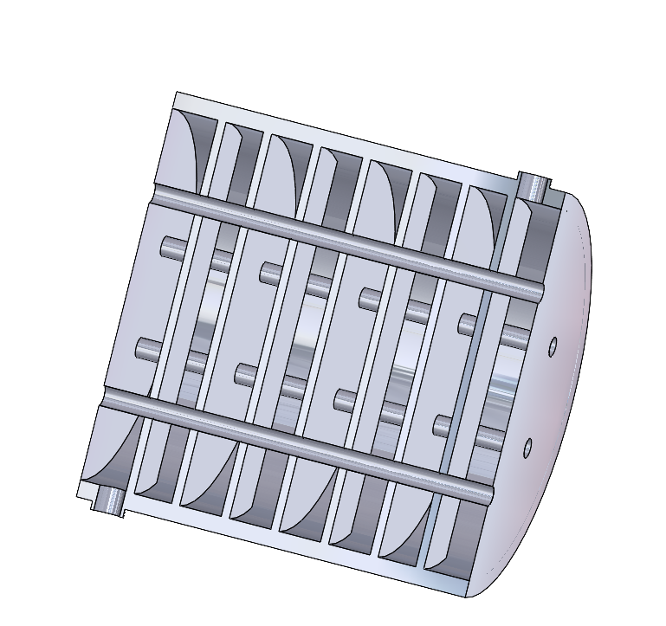
Selected Design
Heat Exchanger:
6 Tubes
Pure Copper
.25 in. ID
Coolant:
50/50 Water-Propylene Glycol
Cooler:
Polyurethane Insulation
100 lbs of Ice
6 gal of water
Fig 6. Baffled Heat Exchanger Shell
Fig 7. Shell and tube Cutaway View
Chris 10/10 BoeingHX F23toSp2405, 16

Slide 18
Budget
Table 3. Tentative Bill of Materials
Project Funding
$5,000 provided by Boeing
$1,000 provided by VA
Total Income: $ 6,000.00
Known Expenses: $ 465.69
_______________________________
Available Capital: $ 5,534.31
Part Name | Qty | Unit Cost | Cost
Igloo Cooler | 1 | $109.99 | $109.99
Radiator | 1 | $22.99 | $22.99
Copper Tubing | 6 | $6.95 | $41.70
Pump | 2 | $68.99 | $137.98
Fan | 2 | $22.56 | $45.12
Acrylic Tubing | 1 | $51.99 | $51.99
Fan Power Supply | 1 | $15.95 | $15.95
Pump Power Supply | 1 | $14.91 | $14.91
Ice | 14 | $1.79 | $25.06
 |  | Total | $465.69
Lorenz 10/10 BoeingHX F23toSp2405, 17

Slide 19
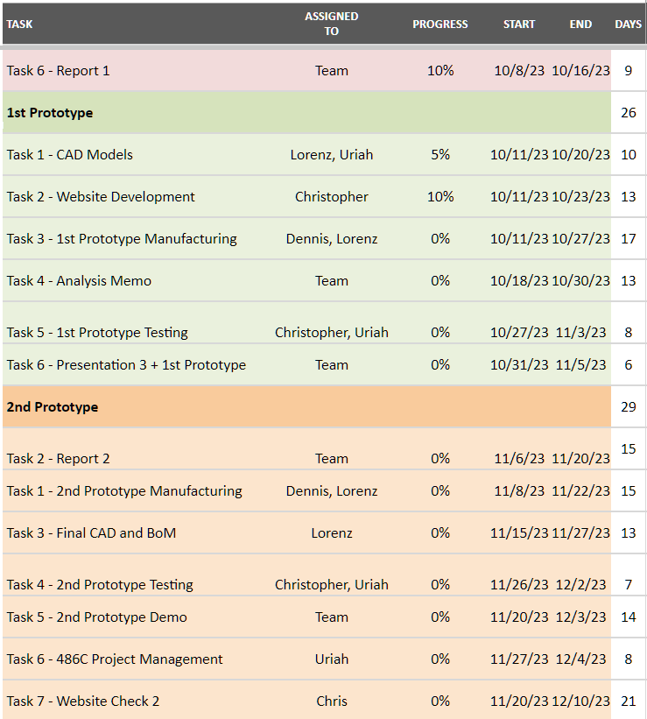
Schedule
Table 4. Gantt Chart 10/8 — 12/10
Dennis 10/10 BoeingHX F23toSp2405, 18

Slide 20
Website
Click Here
Chris 10/10 BoeingHX F23toSp2405, 19

Slide 21
Thank You

Slide 22
References
[1] T. L. BERGMAN, Fundamentals of heat and mass transfer, S.l.: WILEY, 2020
[2] tec-science, “Final temperature of mixtures (Richmann’s law),” tec-science, Jan. 20, 2021.
[3] R. S. Figliola and D. E. Beasley, Theory and Design for Mechanical Measurements. Hoboken, NJ: John Wiley, 2006.
[4] R. W. Fox, Fox And Mcdonald’s Introduction To Fluid Mechanics. S.L.: John Wiley, 2020.

